Slide 1
Russian on the curriculum

Slide 2
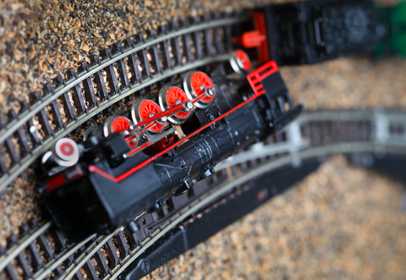

Slide 3
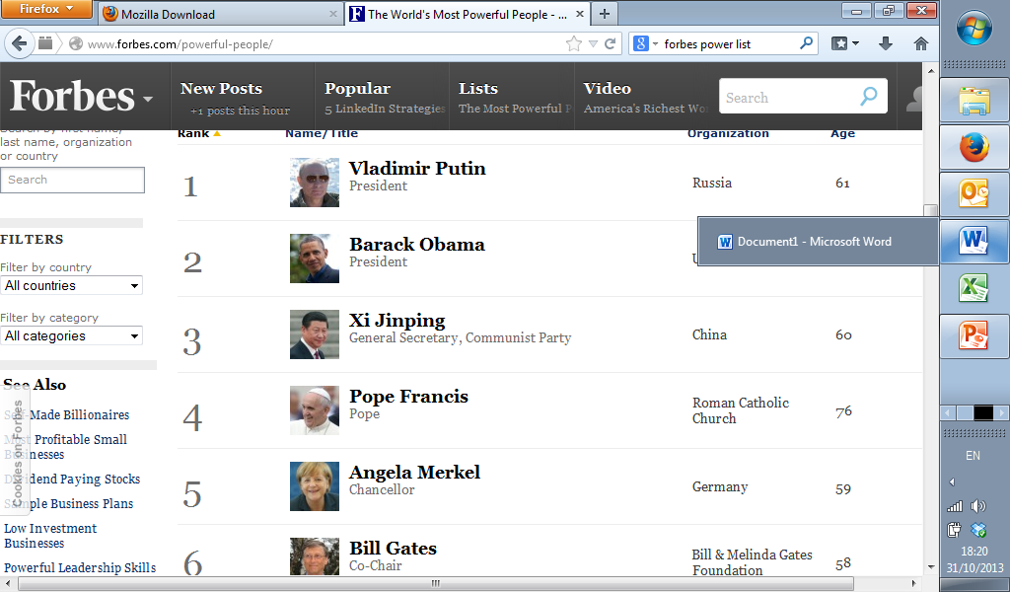
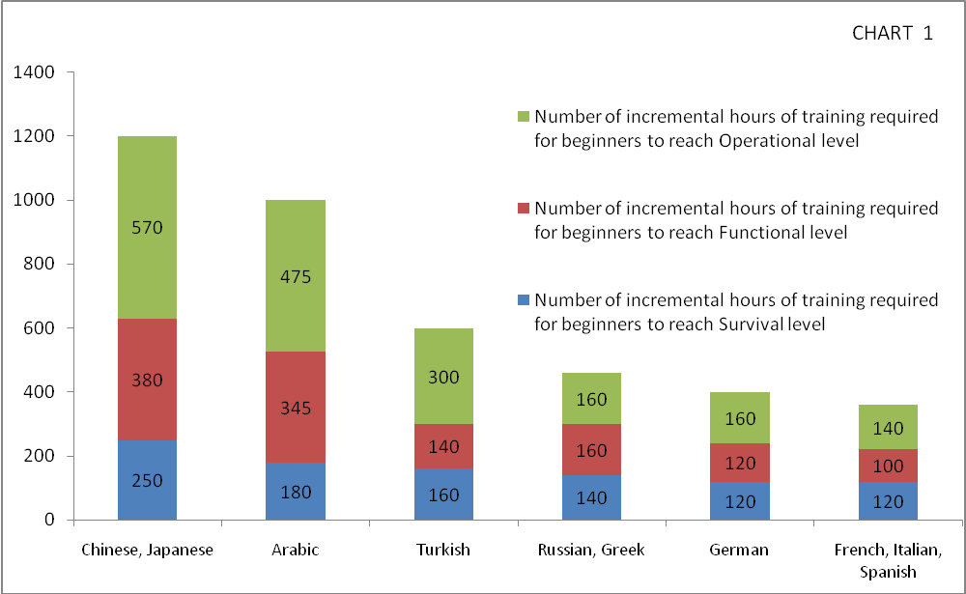
No longer taught in schools
+ (assoc?) decline in universities
Little / no official support or finance
Myths:
Not relevant
Difficult

Slide 5
Russian (re)established as a core language in a diverse menu for schools
End Russian isolation

Slide 7
Official (Russian) support
2nd language under 1+2
What can the SRF do? And how can you help?

Slide 8
What can the SRF do?
Tasters and Russian clubs
Ad hoc programme of one off tasters P2-S6
1+2: Now concentrating on Primary
Successful programme in Glasgow led to help and funding from the council
Have keen students willing to offer the same as volunteers in Edinburgh and need to find interested schools

Slide 9
How you might help
Ideas for inclusion of Russian language / culture in multilingual initiatives
Schools
СПАСИБО!

